Slide 1
GRADE 7 ACCELERATED · UNIT 5 · LESSON 1
Scale Drawings
MA.7.GR.1.5
I can find the scale factor between two figures, and use a scale to find a real length from a drawing or a drawing length from the real one.
Grade 7 Accelerated · Unit 5 · Lesson 1 — Scale Drawings
1

Slide 2



Warm-Up
1. Find the value:
2. Find the value:
3. Write
as a number.
4. On a map, 3 cm stands for 12 km. What does 1 cm stand for?
Grade 7 Accelerated · Unit 5 · Lesson 1 — Scale Drawings
2

Slide 3
Warm-Up
1. Find the value:
−5
2. Find the value:
9
3. Write
as a number.
2,500
4. On a map, 3 cm stands for 12 km. What does 1 cm stand for?
4 km
Grade 7 Accelerated · Unit 5 · Lesson 1 — Scale Drawings
3

Slide 4



Vocabulary
scale drawing
a drawing of a real thing with every length multiplied by the same number: a map, a floor plan, a model
scale factor
the number every length is multiplied by, written
: from 4 cm to 6 cm,
corresponding sides
the side of the copy that matches a side of the original: the 6 cm side matches the 4 cm side
scale
a scale factor with units on it:
means every inch on the map is 20 miles
Grade 7 Accelerated · Unit 5 · Lesson 1 — Scale Drawings
4

Slide 5
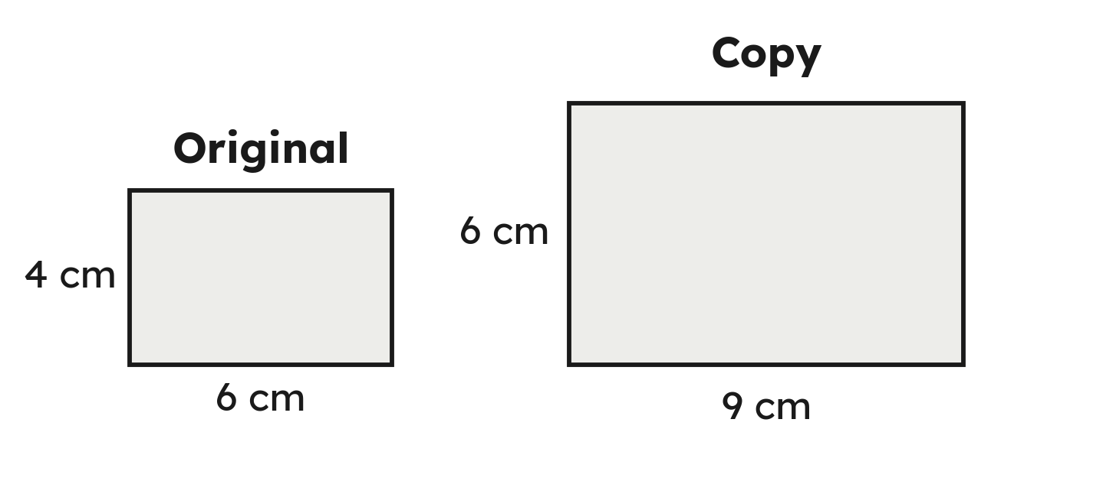
Notes
I. A scale copy: every side times the same number
Every angle is still 90°: k multiplies lengths, not angles.
Grade 7 Accelerated · Unit 5 · Lesson 1 — Scale Drawings
5

Slide 6
Notes
II. Find k: copy divided by original — and k can be less than 1
k = copy ÷ original. Less than 1 shrinks, more than 1 enlarges, 1 is the same size.
Grade 7 Accelerated · Unit 5 · Lesson 1 — Scale Drawings
6

Slide 7
Notes
III. Use k both ways
To the copy, multiply by k. Back to the original, divide by k.
Grade 7 Accelerated · Unit 5 · Lesson 1 — Scale Drawings
7

Slide 8
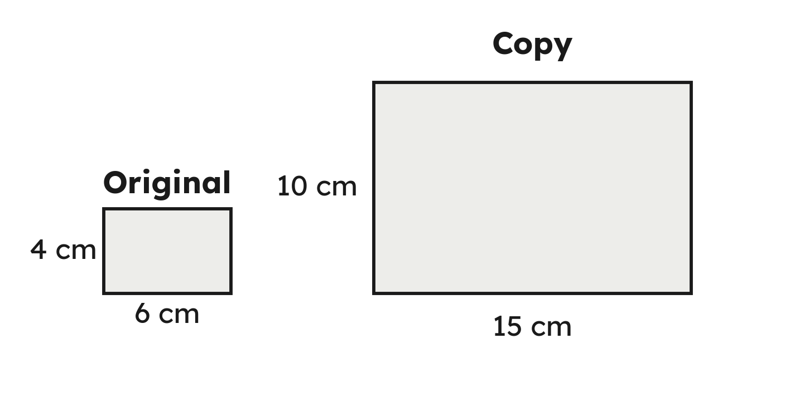
Example 1
A 6 cm by 4 cm rectangle is copied at 15 cm by 10 cm.
Find the scale factor.
Grade 7 Accelerated · Unit 5 · Lesson 1 — Scale Drawings
8

Slide 9
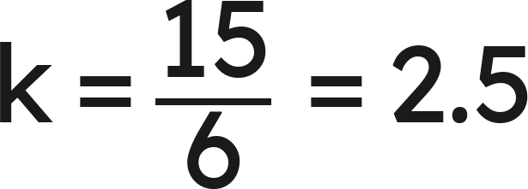
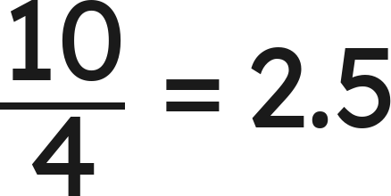
Example 1
Answer: k = 2.5
Grade 7 Accelerated · Unit 5 · Lesson 1 — Scale Drawings
9

Slide 10
Your Turn
An 8 cm by 10 cm rectangle is copied at 12 cm by 15 cm.
Find the scale factor.
Grade 7 Accelerated · Unit 5 · Lesson 1 — Scale Drawings
10

Slide 11
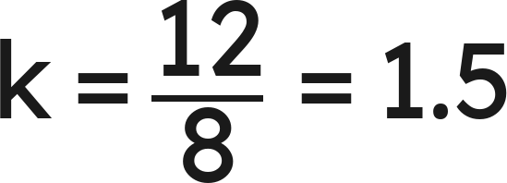
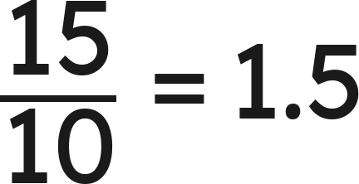
Your Turn
An 8 cm by 10 cm rectangle is copied at 12 cm by 15 cm.
Find the scale factor.
— the same k
Answer: k = 1.5
Grade 7 Accelerated · Unit 5 · Lesson 1 — Scale Drawings
11

Slide 12

Example 2
A map's scale is
.
Two towns are 2.6 in apart on the map.
How far apart are the towns?
Grade 7 Accelerated · Unit 5 · Lesson 1 — Scale Drawings
12

Slide 13

Example 2
Answer: 65 mi
Grade 7 Accelerated · Unit 5 · Lesson 1 — Scale Drawings
13

Slide 14

Your Turn
A map's scale is
.
Two towns are 4.2 cm apart on the map.
How far apart are the towns?
Grade 7 Accelerated · Unit 5 · Lesson 1 — Scale Drawings
14

Slide 15


Your Turn
A map's scale is
.
Two towns are 4.2 cm apart on the map.
How far apart are the towns?
Answer: 63 km
Grade 7 Accelerated · Unit 5 · Lesson 1 — Scale Drawings
15

Slide 16
Whiteboards · Question 1 of 9
A 2 cm side becomes 6 cm in the copy.
What is the scale factor?
Answer it.
Grade 7 Accelerated · Unit 5 · Lesson 1 — Scale Drawings
16

Slide 17
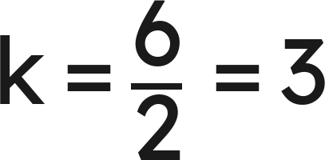
Whiteboards · Question 1 of 9
A 2 cm side becomes 6 cm in the copy.
What is the scale factor?
Answer: k = 3
Grade 7 Accelerated · Unit 5 · Lesson 1 — Scale Drawings
17

Slide 18
Whiteboards · Question 2 of 9
An 8 cm side becomes 4 cm in the copy.
What is the scale factor?
Answer it.
Grade 7 Accelerated · Unit 5 · Lesson 1 — Scale Drawings
18

Slide 19
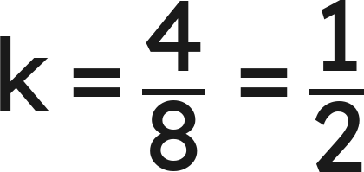
Whiteboards · Question 2 of 9
An 8 cm side becomes 4 cm in the copy.
What is the scale factor?
Answer: k = ½
Grade 7 Accelerated · Unit 5 · Lesson 1 — Scale Drawings
19

Slide 20
Whiteboards · Question 3 of 9
A 12 cm side becomes 9 cm in the copy.
What is the scale factor?
Answer it.
Grade 7 Accelerated · Unit 5 · Lesson 1 — Scale Drawings
20

Slide 21
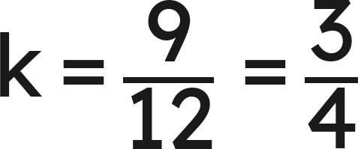
Whiteboards · Question 3 of 9
A 12 cm side becomes 9 cm in the copy.
What is the scale factor?
Answer: k = ¾
Grade 7 Accelerated · Unit 5 · Lesson 1 — Scale Drawings
21

Slide 22




Whiteboards · Question 4 of 9
A side of 5 cm becomes 2 cm in the copy.
What is the scale factor?
A.
B.
C.
D.
Answer it.
Grade 7 Accelerated · Unit 5 · Lesson 1 — Scale Drawings
22

Slide 23
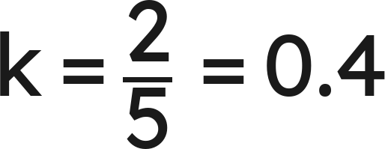
Whiteboards · Question 4 of 9
A side of 5 cm becomes 2 cm in the copy.
What is the scale factor?
Answer: B — 0.4
Grade 7 Accelerated · Unit 5 · Lesson 1 — Scale Drawings
23

Slide 24
Whiteboards · Question 5 of 9
The scale factor is 3.5. A side of the original is 6 cm.
How long is that side in the copy?
Answer it.
Grade 7 Accelerated · Unit 5 · Lesson 1 — Scale Drawings
24

Slide 25

Whiteboards · Question 5 of 9
The scale factor is 3.5. A side of the original is 6 cm.
How long is that side in the copy?
Answer: 21 cm
Grade 7 Accelerated · Unit 5 · Lesson 1 — Scale Drawings
25

Slide 26





Whiteboards · Question 6 of 9
A drawing has a 40° angle. The real figure is a scale copy at
.
What is the angle in the real figure?
A.
B.
C.
D.
Answer it.
Grade 7 Accelerated · Unit 5 · Lesson 1 — Scale Drawings
26

Slide 27


Whiteboards · Question 6 of 9
A drawing has a 40° angle. The real figure is a scale copy at
.
What is the angle in the real figure?
Lengths are multiplied by k. Angles are not.
Answer: A — 40°
Grade 7 Accelerated · Unit 5 · Lesson 1 — Scale Drawings
27

Slide 28
Whiteboards · Question 7 of 9
A triangle has sides 6, 8 and 10. Another has sides 9, 12 and 15; a third has sides 9, 12 and 14.
Which one is a scale copy of the first?
Answer it.
Grade 7 Accelerated · Unit 5 · Lesson 1 — Scale Drawings
28

Slide 29
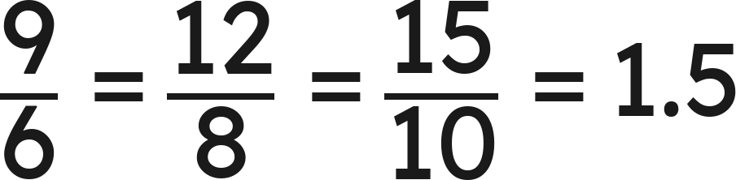
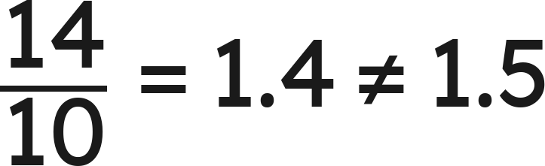
Whiteboards · Question 7 of 9
A triangle has sides 6, 8 and 10. Another has sides 9, 12 and 15; a third has sides 9, 12 and 14.
Which one is a scale copy of the first?
: the second is a copy
: the third is not
Answer: The 9-12-15 triangle (k = 1.5); the 9-12-14 one is not a copy
Grade 7 Accelerated · Unit 5 · Lesson 1 — Scale Drawings
29

Slide 30
Whiteboards · Question 8 of 9
Dev, who is 13, draws a 15-ft wall as 3 in long.
How long is a 20-ft wall on his drawing?
Answer it.
Grade 7 Accelerated · Unit 5 · Lesson 1 — Scale Drawings
30

Slide 31


Whiteboards · Question 8 of 9
Dev, who is 13, draws a 15-ft wall as 3 in long.
How long is a 20-ft wall on his drawing?
: every inch is 5 ft
Answer: 4 in
Grade 7 Accelerated · Unit 5 · Lesson 1 — Scale Drawings
31

Slide 32
Whiteboards · Question 9 of 9
Priya says the scale factor from a 6 cm side to its 3 cm copy is 2.
Is she right? Explain.
Write your answer in sentences.
Grade 7 Accelerated · Unit 5 · Lesson 1 — Scale Drawings
32

Slide 33
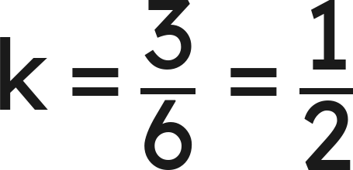
Whiteboards · Question 9 of 9
Priya says the scale factor from a 6 cm side to its 3 cm copy is 2.
Is she right? Explain.
. No: the copy is smaller, so k is under 1.
Answer: No. k = 3 ÷ 6 = ½: the copy is smaller, so k is under 1.
Grade 7 Accelerated · Unit 5 · Lesson 1 — Scale Drawings
33

Slide 34

Independent Set
1.
A 5 cm side becomes 15 cm in the copy. Find the scale factor.
2.
A 15 cm side becomes 6 cm in the copy. Find the scale factor.
3.
A 3 cm by 5 cm rectangle is copied at 7.5 cm by 12.5 cm. Find the scale
factor.
4.
The scale factor is 1.5 and a side of the original is 8 cm. How long is that
side in the copy?
5.
A map's scale is
. Two cities are 2.8 in apart on the map. How far
apart are they?
6.
On the same map, a road is 150 mi long. How long is it on the map?
Grade 7 Accelerated · Unit 5 · Lesson 1 — Scale Drawings
34

Slide 35
IXL
1.
Open IXL and start today's skills.
2.
Work on paper where the question needs work. The answer box does not show it.
3.
Every skill listed is required, to a SmartScore of 67. Due at the start of the next class.
Today's skills — all required
Scale drawings: find the scale factor, missing side, or missing angle — WEA
Grade 7 Accelerated · Unit 5 · Lesson 1 — Scale Drawings
35

